Slide 1




PDS
Computer Vision
Chapter 5-2a:
Neural Network
https://github.com/siagianp
https://github.com/amelcharolinesgn2/IoT_simulator-mqtt-NodeRed
https://www.youtube.com/@AmelOline/videos
Notes:
https://medium.com/buildpiper/simplifying-containerization-with-docker-run-command-2f74e114f42a
https://github.com/IBA-Group-IT/IoT-data-simulator
https://www.bevywise.com/blog/docker-mqtt-broker-easy-service-manageability/

Slide 2
Outlines
Network of Neuron in Brain
Neural Networks
Training Neural Networks
Mini Batch SGD

Slide 3
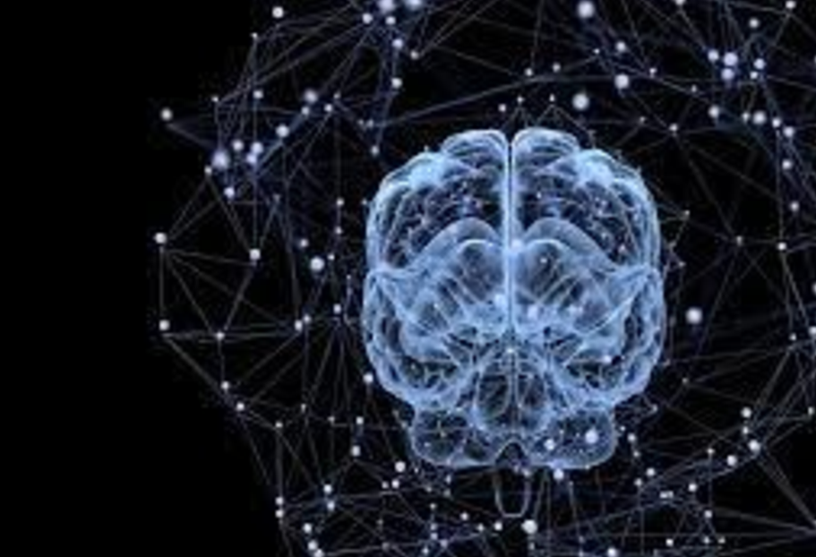
Network of Neuron in Brain
PDS
Computer Vision

Slide 4
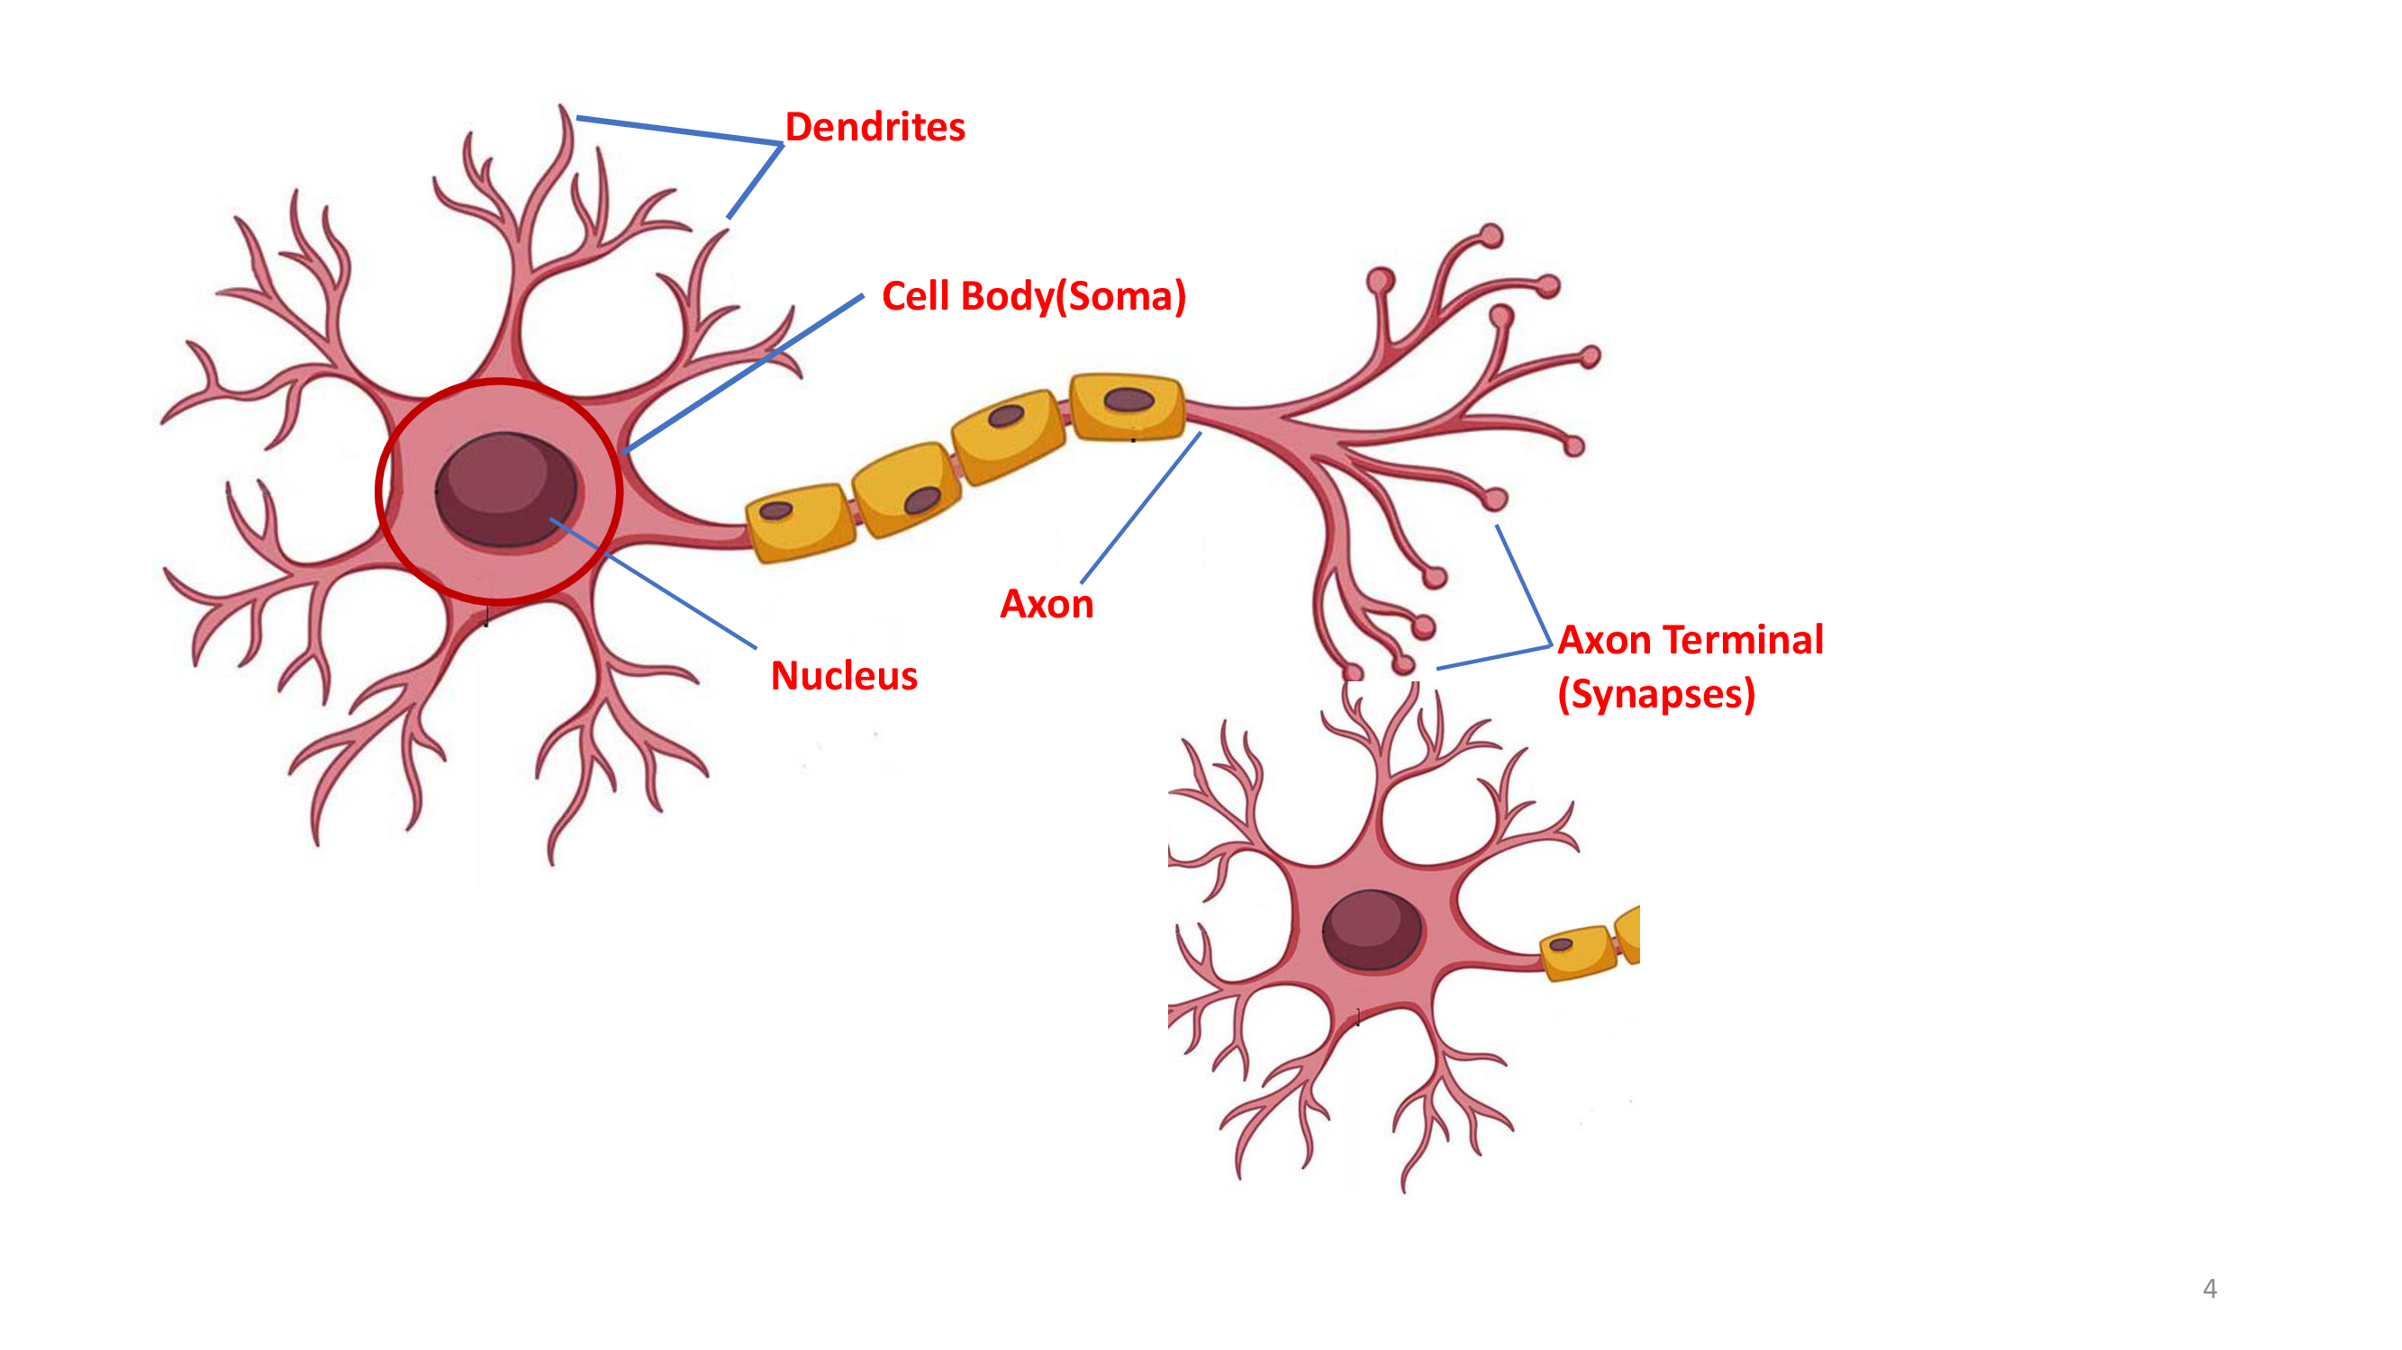

Slide 5
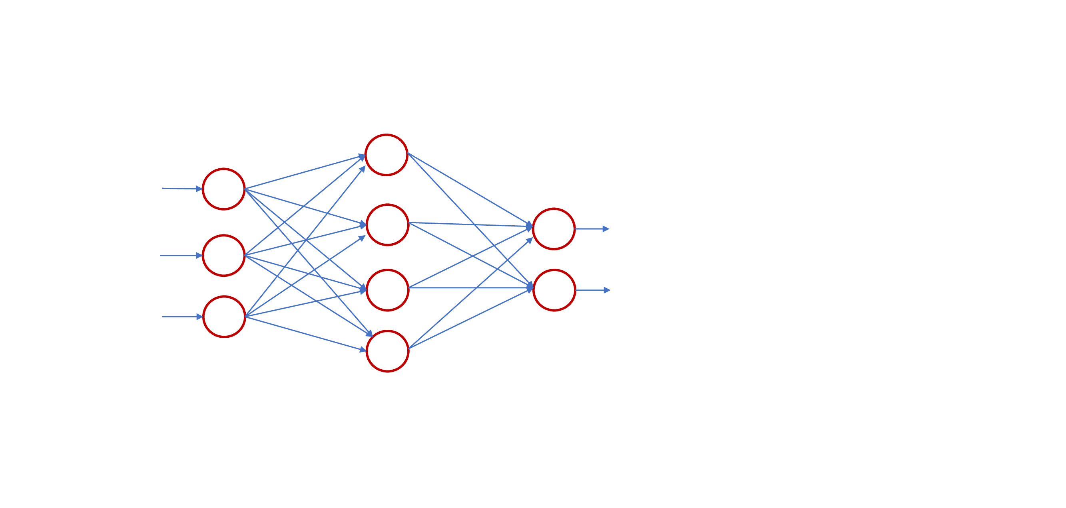

Slide 6
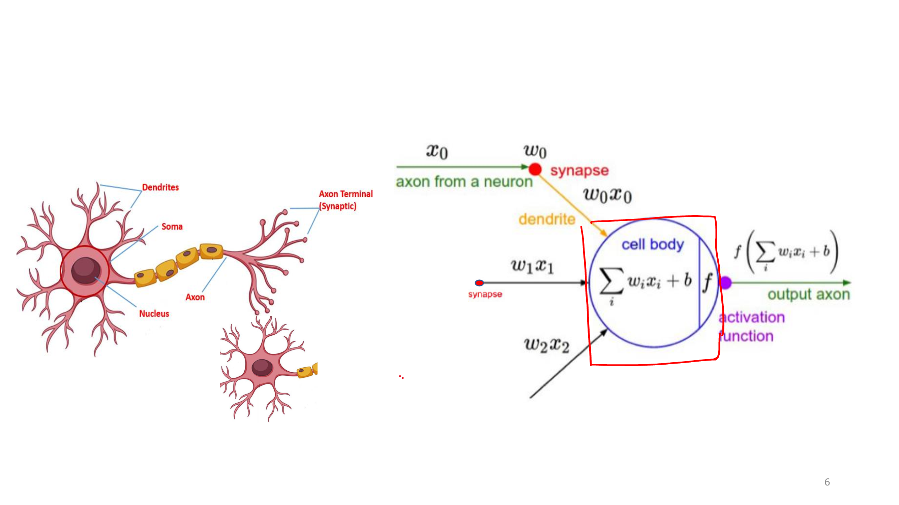

Slide 7
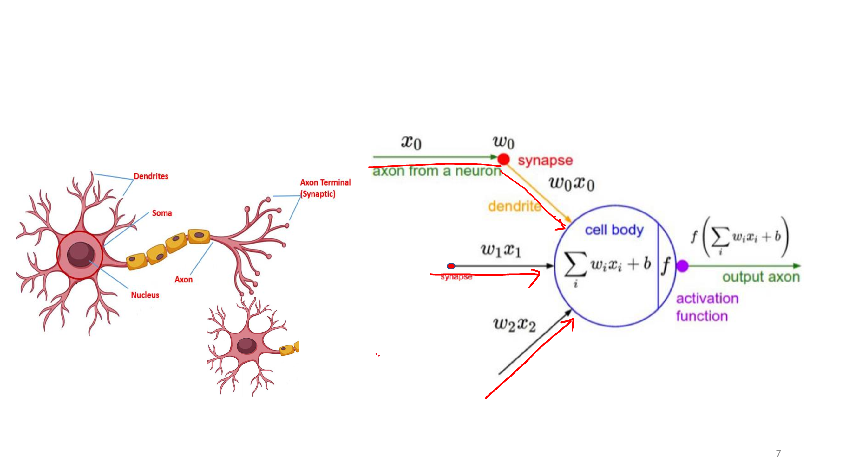

Slide 8
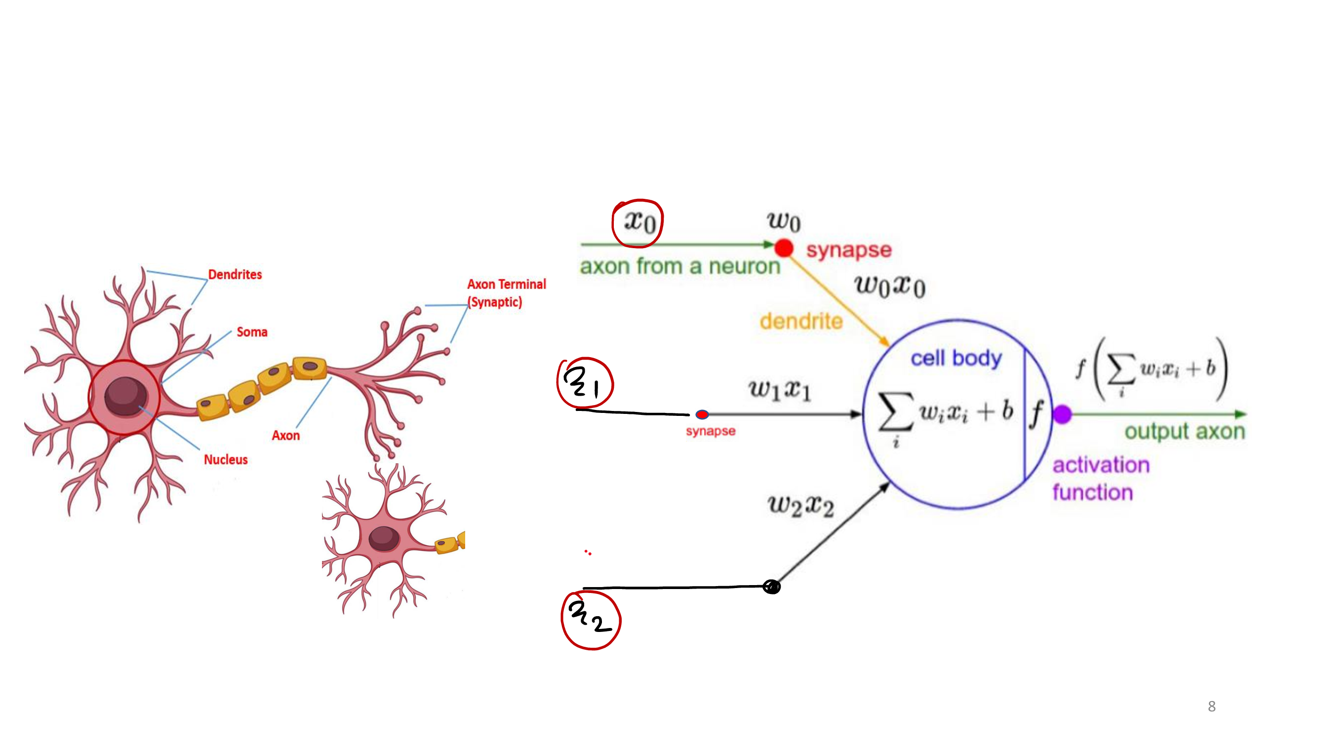

Slide 9
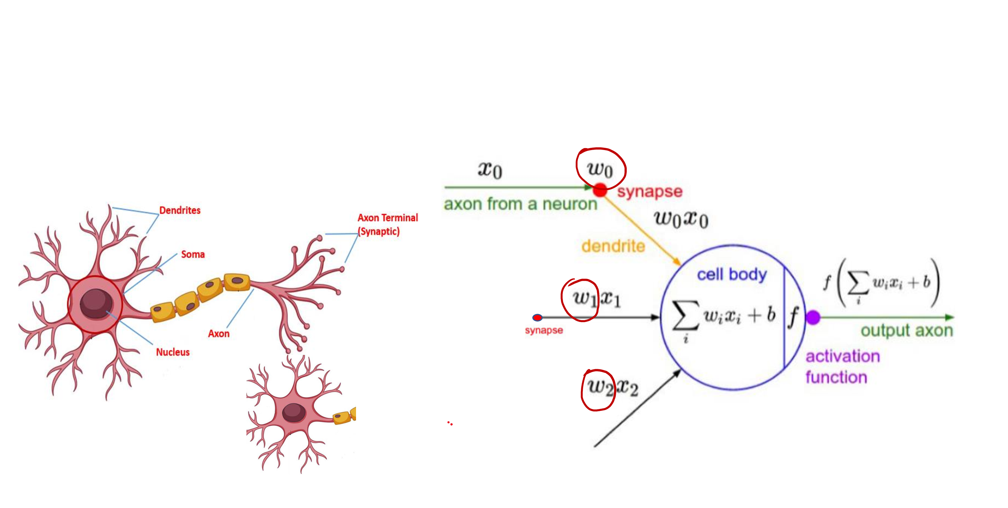

Slide 10
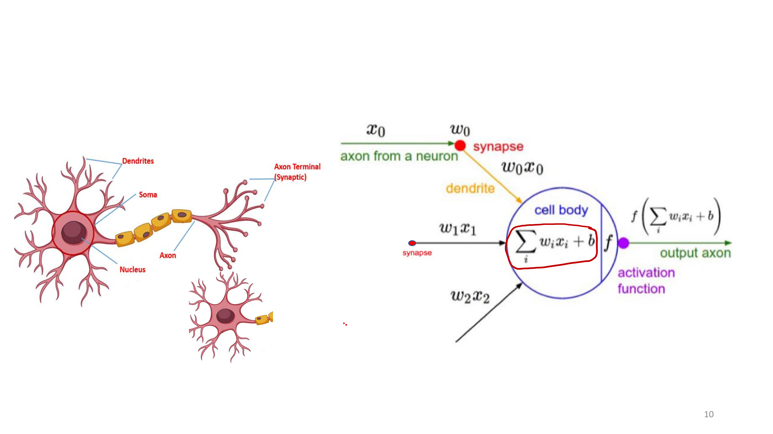

Slide 11
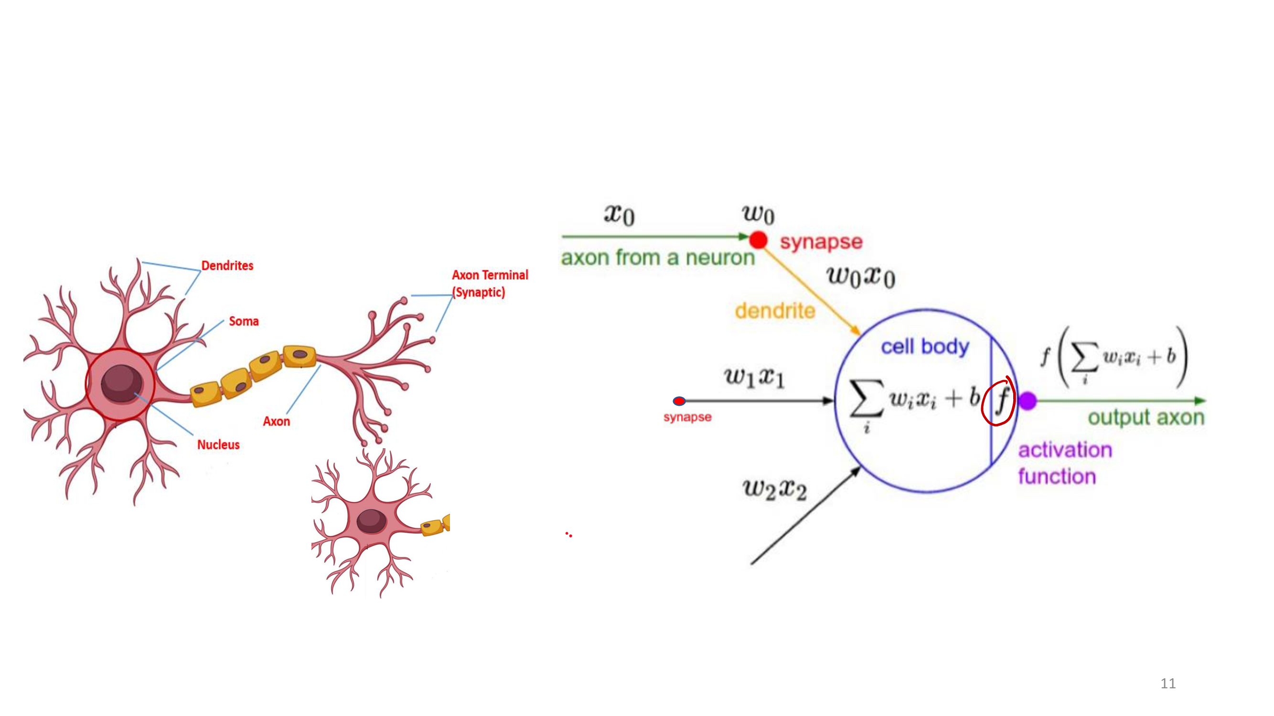

Slide 12
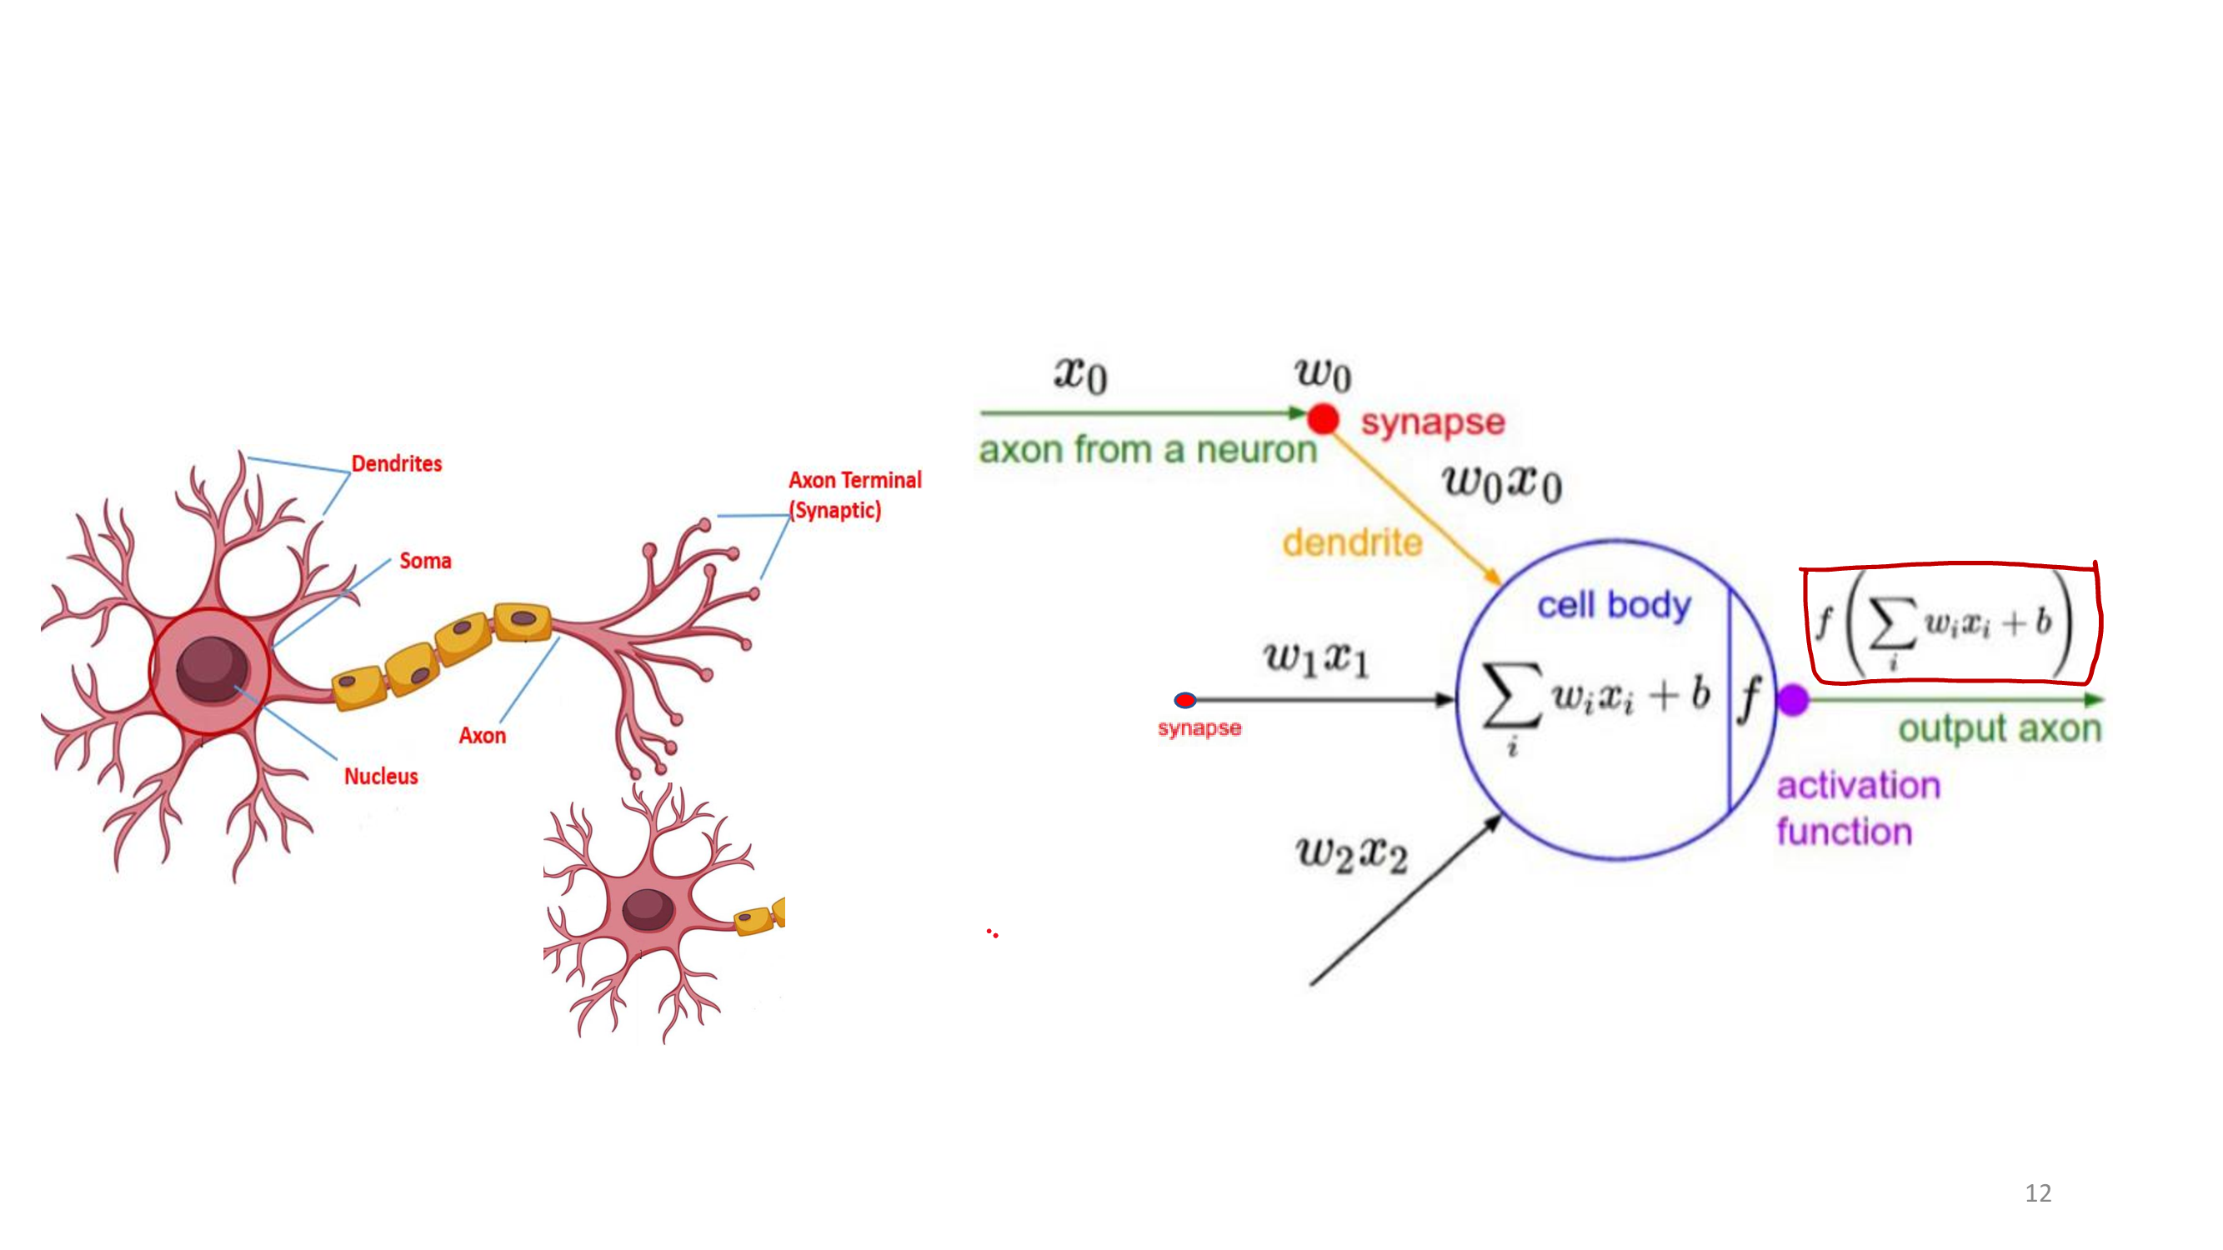

Slide 13
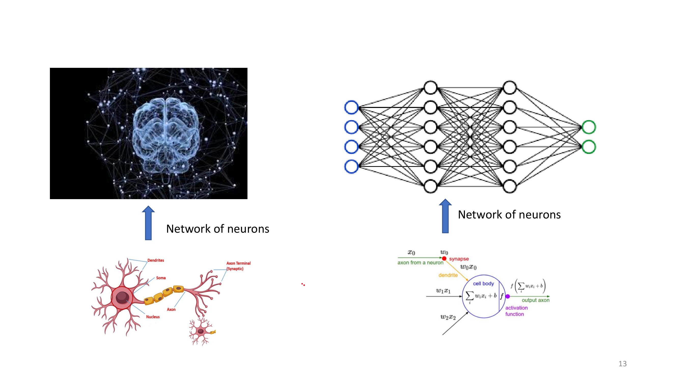

Slide 14
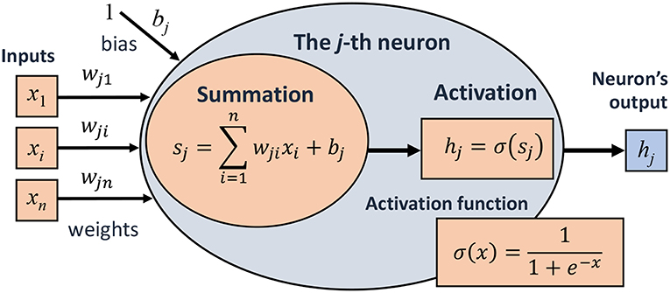
Neural Networks
PDS
Computer Vision

Slide 15
Neural Networks
Origins: Algorithms that try to mimic the brain
40s and 50s: Hebbian learning and Perceptron
Perceptrons book in 1969 and the XOR problem
Very widely used in 80s and early 90s; popularity diminished in late 90s.
Recent resurgence: technique for many applications
Artificial neural networks are not nearly as complex or intricate as the actual brain structure
NN

Slide 16
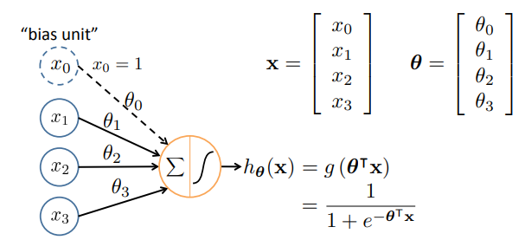
Single Node
1
Sigmoid (logistic) activation function:
g(z) =
1 + e^{—z}
NN

Slide 17
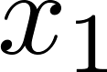
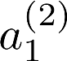
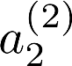
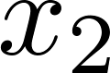
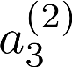
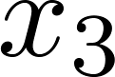
Neural Network
bias units
x₀
_{a}(2)
0
h✓ (x)
Layer 1
(Input Layer)
Layer 2
(Hidden Layer)
Layer 3
(Output Layer)

Slide 18
Neural networks Terminology
Output units
Hidden units Input units
Layered feed-forward network
Neural networks are made up of nodes or units, connected by links
Each link has an associated weight and activation level
Each node has an input function (typically summing over weighted inputs), an activation function, and an output

Slide 19
Feed-Forward Process
Input layer units are set by external data, which causes their output links to be activated at the specified level
Working forward through the network, the input function of each unit is applied to compute the input value
- Usually this is just the weighted sum of the activation on the links feeding into this node
The activation function transforms this input function into a final value
Typically this is a nonlinear function, often a sigmoid
function corresponding to the “threshold” of that node

Slide 20
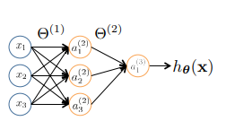
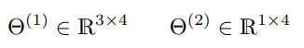
a ^{(j)} = “activation” of unit i in layer j
i
Θ^{(j)} = weight matrix stores parameters from layer j to layer j + 1
If network has s_{j} units in layer j and s_{j+1} units in layer j+1, then Θ^{(j)} has dimension s_{j+1} × (s_{j}+1) .

Slide 21
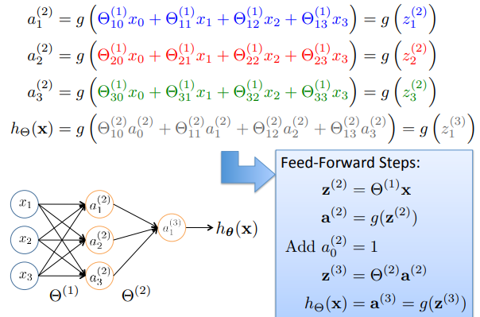
Vectorization

Slide 22
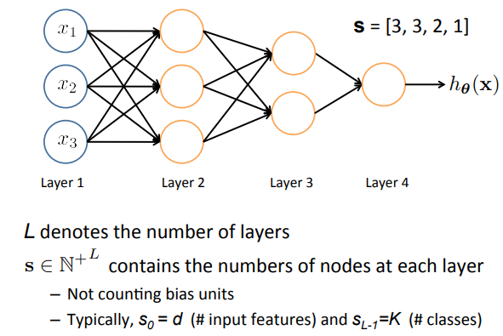
Other Network Architectures

Slide 23


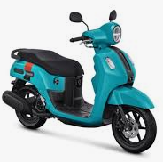

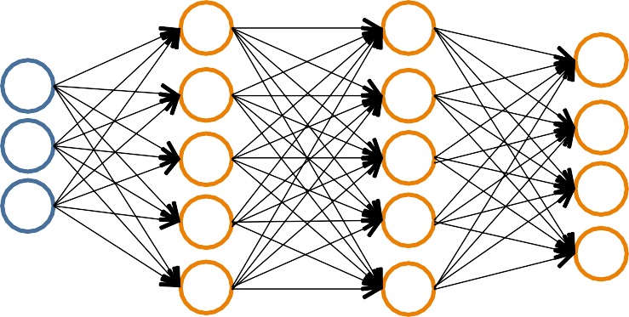
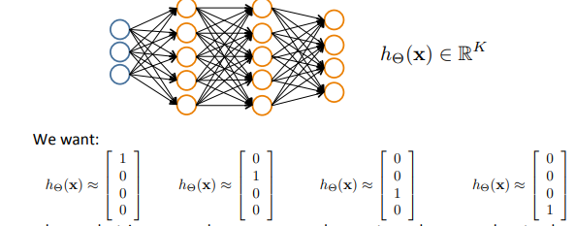
Multiple Output Units: One vs Rest
Pedestrian
Car
Motorcycle
Truck
when pedestrian
when car
when motorcycle
when truck

Slide 24
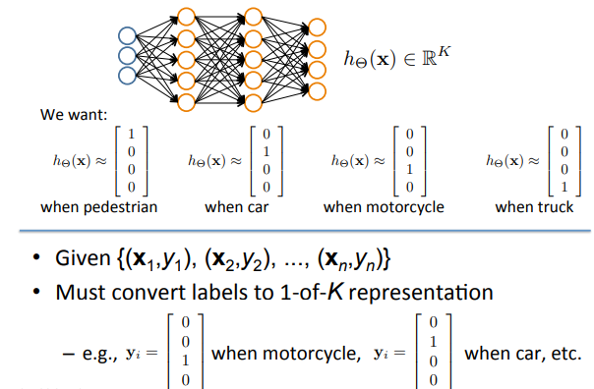
Multiple Output Units: One vs Rest
NN

Slide 25
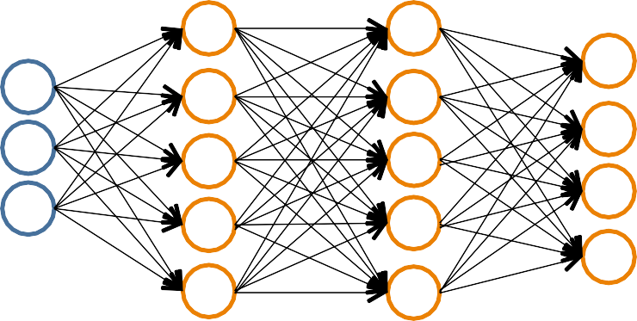
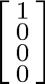
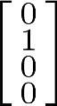
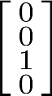
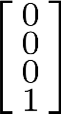
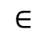
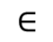
Neural Network Classification
Given:
{(x₁,y₁), (x₂,y₂), ..., (x_{n},y_{n})}
s
N^{+L}contains # nodes at each layer
– s₀ = d (# features)
$$∈$$
Binary classification
y = 0 or 1
Multi class classification (K classes)
y R^{K}
e.g. , , ,
pedestrian car motorcycle truck
$$∈$$
1 output unit (s = 1)
L-1
K output units (s_{L-1}= K)

Slide 26
Understanding Representations
20

Slide 27
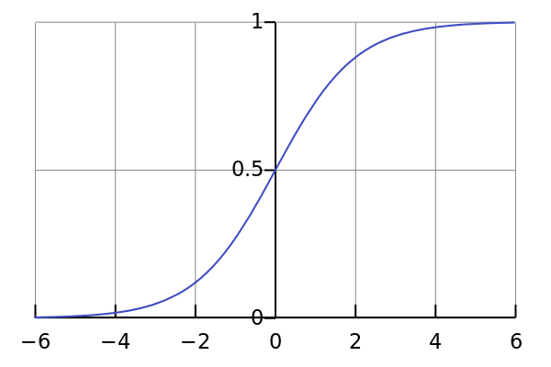
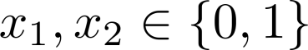
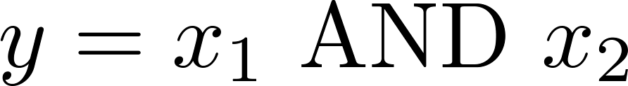
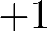
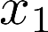
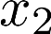
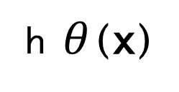
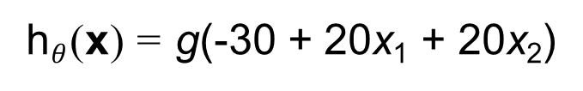
Representing Boolean Functions
Logistic / Sigmoid Function
Simple example: AND
g(z)
- 30
- -
+20
h $θ$ (x)
+20
x₁
x₂
h_{Θ}(x)
x₁
x₂
h_{Θ}(x)
h$θ$(x) = g(-30 + 20x₁ + 20x₂)
0
0
1
1
0
1
0
1
g(-30) ≈ 0
g(- 10) ≈ 0
g(-10) ≈ 0
g(10) ≈ 1
0
0
0
1
1
0
1
1

Slide 28
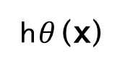
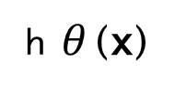
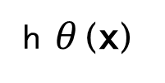
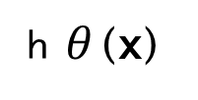
Representing Boolean Functions
- 3 0
+20
AND
OR
- 10
h $θ$ (x)
+20
h $θ$ (x)
+20
+20
NOT
(NOT x₁) AND (NOT x₂)
+10
+10
h $θ$ (x)
-20
h$θ$ (x)
- 20
-20
22

Slide 29






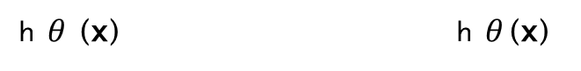
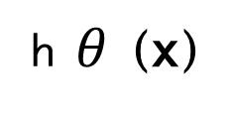
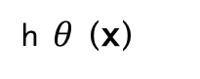
Combining Representations to Create Non Linier Function
(NOT x₁) AND (NOT x₂)
AND OR
-30
+20
+10
-20
-10
+20
h $θ$(x) h $θ$ (x)
h $θ$(x)
+20
-20
+20
NOT XOR
-10
II
I
-30
+20
+20
+10
in I
+20
h $θ$ (x)
-20
-20
in III
+20
III
IV
I or III

Slide 30
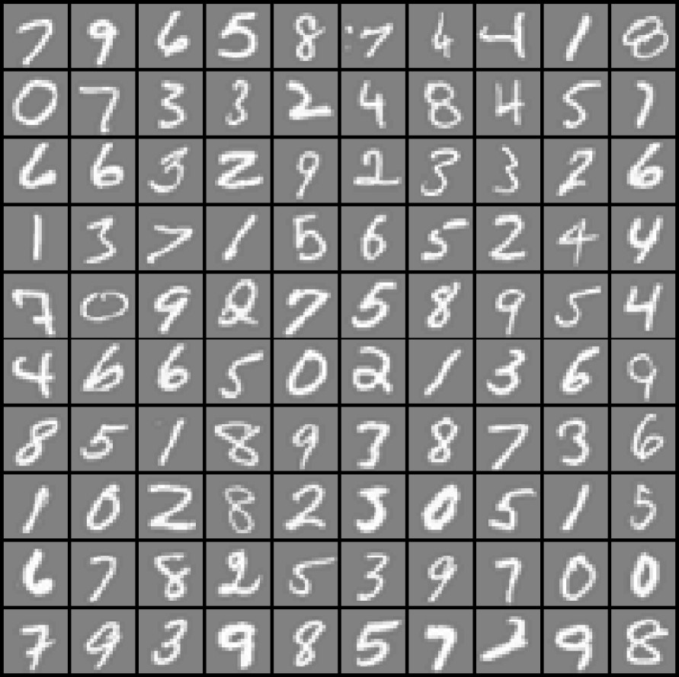

Layering Representations
x₁ ... x₂₀
x₂₁ ... x₄₀
x₄₁ ... x₆₀
...
^{x}381 ^{... x}400
20 × 20 pixel images
d = 400 10 classes
Each image is “unrolled” into a vector x of pixel intensities

Slide 31

Layering Representations
x₁ x₂
“0”
“1”
x
3
x₄ x₅
“9”
Output Layer
x_{d}
Input Layer
Hidden Layer

Slide 32
Neural Network Learning

Slide 33

Perceptron Learning Rule
Intuitive rule:
If output is correct, don’t change the weights
If output is low (h(x) = 0, y = 1), increment weights for all the inputs which are 1
If output is high (h(x) = 1, y = 0), decrement weights for all inputs which are 1
Perceptron Convergence Theorem:
If there is a set of weights that is consistent with the training data (i.e., the data is linearly separable), the perceptron learning algorithm will converge [Minksy & Papert, 1969]
3

Slide 34






Batch Perceptron
(i) (i)
n i=1
}
Given training data (x , y )
Let $θ$ ← [0, 0,. .., 0]
Repeat:
Let A ← [0, 0,. .., 0]
for i = 1 .. . n, do
_{if y}(i)_{x}(i) $θ$
0
// prediction for i^{th} instance is incorrect
_{A ← A + y}(i)_{x}(i)
A ← A/n
// compute average update
Simplest case: α = 1 and don’t normalize, yields the fixed increment perceptron
Each increment of outer loop is called an epoch

Slide 35
Learning in NN: Backpropagation
Similar to the perceptron learning algorithm, we cycle through our examples
If the output of the network is correct, no changes are made
If there is an error, weights are adjusted to reduce the error
We are just performing (stochastic) gradient descent!

Slide 36

Cost Function

Slide 37









Optimizing the Neural Network
"
Unlike before, J(Θ) is not convex, so GD on a neural net yields a local optimum
Solve via:
@
_{J(⇥) = a}(l)₆(l+1)
j i
@⇥(l)
(ignoring λ; if λ = 0)
ij
Forward Propagation
Backpropagation
NN

Slide 38

Forward Propagation
Given one labeled training instance (x, y):
Forward Propagation
a⁽¹⁾ = x
_{z}(2) _{= Θ}(1)_{a}(1)
_{a}(1)
_{a}(4)
a⁽²⁾ = g(z⁽²⁾)
_{z}(3) _{= Θ}(2)_{a}(2)
a⁽³⁾ = g(z⁽³⁾)
_{z}(4) _{= Θ}(3)_{a}(3)
[add a ⁽²⁾]
_{a}(2)
_{a}(3)
0
[add a₀⁽³⁾]
a⁽⁴⁾ = h_{Θ}(x) = g(z⁽⁴⁾)
NN

Slide 39






Backpropagation Intuition
₆(2)
₆(3)
₆(4)
1
1
1
₆(2)
₆(3)
2
2
_{δ} (l)
= “error” of node j in layer l
j
Formally,
₆(l)
@
=
cost(x )
j
_{@z}(l)
i
j
where cost(x_{i}) = y_{i} log h⇥(x_{i}) + (1 — y_{i}) log(1 — h⇥(x_{i}))
NN

Slide 40


Backpropagation Intuition
₆(2)
₆(3)
₆(4)
1
1
1
_{δ}(4) _{= a} (4) _{– y}
6₂
(2)
6₂
(3)
1
_{δ} (l)
= “error” of node j in layer l
j
Formally,
₆(l)
@
=
cost(x )
j
_{@z}(l)
i
j
where cost(x_{i}) = y_{i} log h⇥(x_{i}) + (1 — y_{i}) log(1 — h⇥(x_{i}))
NN

Slide 41




Backpropagation Intuition
₆(2)
₆(3)
₆(4)
1
1
1
⇥(3)
12
₆(2)
₆(3)
2
2
_{δ2}(3) _{= Θ}
(3) _{×δ} (4)
12
1
_{δ} (l)
= “error” of node j in layer l
j
Formally,
₆(l)
@
=
cost(x )
j
_{@z}(l)
i
j
where cost(x_{i}) = y_{i} log h⇥(x_{i}) + (1 — y_{i}) log(1 — h⇥(x_{i}))
NN

Slide 42



Backpropagation Intuition
₆(2)
₆(3)
₆(4)
1
1
1
₆(2)
₆(3)
2
2
_{δ2}(3) _{= Θ} (3) _{×δ} (4)
12 1
_{δ1}(3) _{= Θ11}(3) _{×δ1} )
(4
δ ^{(l)} = “error” of node j in layer l
j
@
Formally, 6^{(l)} =
cost(x )
j
_{@z}(l)
i
j
where cost(x_{i}) = y_{i} log h⇥(x_{i}) + (1 — y_{i}) log(1 — h⇥(x_{i}))
NN
40

Slide 43









Backpropagation Intuition
₆(2)
₆(3)
₆(4)
1
⇥(2)
1
1
12
₆(2)
⇥(2)
₆(3)
2
22
2
δ₂⁽²⁾ = Θ₁₂ ⁾ ×δ₁ + Θ₂₂ ×δ₂
(2 (3) (2) (3)
δ ^{(l)} = “error” of node j in layer l
j
@
Formally, 6^{(l)} =
cost(x )
j
_{@z}(l)
i
j
where cost(x_{i}) = y_{i} log h⇥(x_{i}) + (1 — y_{i}) log(1 — h⇥(x_{i}))
NN

Slide 44
























Backpropagation: Gradient Computation
Let δ_{j} = “error” of node j in layer l
(l)
(#layers L = 4)
Element@wise product .*
_{δ}(4)
Backpropagation
_{δ}(2) _{δ}(3)
g’(z⁽³⁾) = a⁽³⁾ .* (1–a⁽³⁾)
_{δ}(4) _{= a}(4) _{– y}
_{δ}(3) _{= (Θ}(3)₎T_{δ}(4) _{.* g}
_{δ}(2) _{= (Θ}(2)₎T_{δ}(3) _{.* g}
(No δ⁽¹⁾)
’(z⁽³⁾)
’(z⁽²⁾)
g’(z⁽²⁾) = a⁽²⁾ .* (1–a⁽²⁾)
_{δ}
_{δ}

Slide 45



Backpropagation
Set ∆^{(l)} = 0 8l, i, j
(Used to accumulate gradient)
ij
For each training instance (x_{i}, y_{i}): Set a⁽¹⁾ = x_{i}
Compute {a⁽²⁾,. .., a^{(L)}} via forward propagation Compute 6^{(L)} = a^{(L)} — y_{i}
Compute errors {6^{(L—1)},. .., 6⁽²⁾}
Compute gradients ∆^{(l)} = ∆^{(l)} + a^{(l)} _{δ}^{(l+1)}
ij ij j i
(
Compute avg regularized gradient D
(l)
ij
=
D^{(l)} is the matrix of partial derivatives of J(Θ)
NN

Slide 46

Training a Neural Network via Gradient Descent with Backprop

Slide 47
Several Practical Tricks
Initialization
Problem is highly non@convex, and heuristics exist to start training (at the least, randomize initial weights)
Optimization tricks
Momentum@based methods
Decaying step size
Dropout to avoid co@adaptation / overfitting Minibatch
Use more than a single point to estimate gradient
…

Slide 48
Neural Networks vs Deep Learning?
DNN are big neural networks
Depth: often ~5 layers (but some have 20+)
– Typically not fully connected!
Width: hidden nodes per layer in the thousands
Parameters: millions to billions
Algorithms / Computing
New algorithms (pre@training, layer@wise training, dropout, etc.)
Heavy computing requirements (GPUs are essential)

Slide 49

Mini Batch SGD
PDS
Computer Vision

Slide 50
Mini-batch SGD
Loop:
Sample a batch of data
Forward prop it through the graph (network), get loss
Backprop to calculate the gradients
Update the parameters using the gradient
NN

Slide 51
Training Neural Networks
NN

Slide 52
1. One time set up: activation functions, preprocessing, weight initialization, regularization, gradient checking
1. Training dynamics: babysitting the learning process, parameter updates, hyperparameter optimization
1. Evaluation: model ensembles, test-time
augmentation, transfer learning
NN

Slide 53
Activation Functions

Slide 54

Activation Functions
NN

Slide 55











Activation Functions
Sigmoid
tanh
Leaky ReLU
Maxout
ReLU
ELU

Slide 56

Activation Functions
Squashes numbers to range [0,1]
Historically popular since they have nice interpretation as a saturating “firing rate” of a neuron
Sigmoid
NN

Slide 57
Activation Functions
Squashes numbers to range [0,1]
Historically popular since they have nice interpretation as a saturating “firing rate” of a neuron
3 problems:
1. Saturated neurons “kill” the
gradients
Sigmoid

Slide 58





x
sigmoid
gate
NN

Slide 59
x
sigmoid
gate
What happens when x = -10?
NN

Slide 60
x
sigmoid
gate
What happens when x = -10?
NN

Slide 61
x
sigmoid
gate
What happens when x = -10? What happens when x = 0?
NN

Slide 62

x
sigmoid
gate
What happens when x = -10? What happens when x = 0?
What happens when x = 10?
NN

Slide 63

x
sigmoid
gate
What happens when x = -10? What happens when x = 0?
What happens when x = 10?
NN

Slide 64
x
sigmoid
gate
Why is this a problem?
If all the gradients flowing back will be
zero and weights will never change
NN

Slide 65
Activation Functions
Squashes numbers to range [-1,1]
zero centered (nice)
still kills gradients when saturated :(
tanh(x)
[LeCun et al., 1991]
NN

Slide 66
- Computes f(x) = max(0,x)
Activation Functions
Does not saturate (in +region)
Very computationally efficient
Converges much faster than sigmoid/tanh in practice (e.g. 6x)
ReLU
(Rectified Linear Unit)
[Krizhevsky et al., 2012]
NN

Slide 67
- Computes f(x) = max(0,x)
Activation Functions
Does not saturate (in +region)
Very computationally efficient
Converges much faster than sigmoid/tanh in practice (e.g. 6x)
Not zero-centered output
ReLU
(Rectified Linear Unit)
NN

Slide 68
- Computes f(x) = max(0,x)
Activation Functions
Does not saturate (in +region)
Very computationally efficient
Converges much faster than sigmoid/tanh in practice (e.g. 6x)
Not zero-centered output
An annoyance:
hint: what is the gradient when x < 0?
ReLU
(Rectified Linear Unit)
NN

Slide 69

x
ReLU
gate
What happens when x = -10? What happens when x = 0?
What happens when x = 10?
NN

Slide 70
active ReLU
DATA AWS
dead ReLU
will never activate
=> never update
NN

Slide 71

Activation Functions
[Mass et al., 2013] [He et al., 2015]
Does not saturate
Computationally efficient
Converges much faster than sigmoid/tanh in practice! (e.g. 6x)
will not “die”.
Leaky ReLU
NN

Slide 72

Activation Functions
[Mass et al., 2013] [He et al., 2015]
Does not saturate
Computationally efficient
Converges much faster than sigmoid/tanh in practice! (e.g. 6x)
will not “die”.
Parametric Rectifier (PReLU)
- Φ(x)
Leaky ReLU
NN

Slide 73


Activation Functions
[Hendrycks et al., 2016]
- Computes f(x) = x*Φ(x)
GELU
(Gaussian Error Linear Unit)
Φ(x)
Sources: https://en.wikipedia.org/wiki/Normal_distribution, https://en.m.wikipedia.org/wiki/File:Cumulative_di stribution_function_for_normal_distribution,_mea n_0_and_sd_1.png
NN

Slide 74

Activation Functions
[Hendrycks et al., 2016]
- Computes f(x) = x*Φ(x)
Source: https://en.m.wikipedia.org/wiki/File:ReLU_and_GELU.svg
GELU
(Gaussian Error Linear Unit)
Φ(x)
Sources: https://en.wikipedia.org/wiki/Normal_distribution, https://en.m.wikipedia.org/wiki/File:Cumulative_di stribution_function_for_normal_distribution,_mea n_0_and_sd_1.png
NN

Slide 75
Activation Functions
[Hendrycks et al., 2016]
- Computes f(x) = x*Φ(x)
Very nice behavior around 0
Smoothness facilitates training in practice
Higher computational cost than ReLU
Large negative values can still have gradient → 0
Source: https://en.m.wikipedia.org/wiki/File:ReLU_and_GELU.svg
GELU
(Gaussian Error Linear Unit)
NN

Slide 76
TLDR: In practice:
Use ReLU. Be careful with your learning rates
Try out Leaky ReLU / PReLU / GELU
- To squeeze out some marginal gains
Don’t use sigmoid or tanh
NN

Slide 77
Data Preprocessing
NN

Slide 78



Data Preprocessing
(Assume X [NxD] is data matrix,
each example in a row)
NN

Slide 79
TLDR: In practice for Images: center only
e.g. consider CIFAR-10 example with [32,32,3] images
Subtract the mean image (e.g. AlexNet) (mean image = [32,32,3] array)
Subtract per-channel mean (e.g. VGGNet) (mean along each channel = 3 numbers)
Subtract per-channel mean and
Divide by per-channel std (e.g. ResNet and beyond) (mean along each channel = 3 numbers)
NN

Slide 80
Weight Initialization
NN

Slide 81

- Q: what happens when W=constant init is used?
NN

Slide 82
- First idea: Small random numbers
(gaussian with zero mean and 1e-2 standard deviation)
NN

Slide 83
- First idea: Small random numbers
(gaussian with zero mean and 1e-2 standard deviation)
Works ~okay for small networks, but problems with deeper networks.
NN

Slide 84

Weight Initialization: Activation statistics
Forward pass for a 6-layer net with hidden size 4096
What will happen to the activations for the last layer?
NN

Slide 85

Weight Initialization: Activation statistics
Forward pass for a 6-layer net with hidden size 4096
All activations tend to zero for deeper network layers
Q: What do the gradients dL/dW look like?
NN

Slide 86
Weight Initialization: Activation statistics
Forward pass for a 6-layer net with hidden size 4096
All activations tend to zero for deeper network layers
Q: What do the gradients dL/dW look like?
A: All zero, no learning =(
NN

Slide 87

Weight Initialization: Activation statistics
Increase std of initial weights from 0.01 to 0.05
What will happen to the activations for the last layer?
NN

Slide 88

Weight Initialization: Activation statistics
All activations saturate
Q: What do the gradients look like?
Increase std of initial weights from 0.01 to 0.05
NN

Slide 89
Weight Initialization: Activation statistics
All activations saturate
Q: What do the gradients look like?
A: Local gradients all zero, no learning =(
Increase std of initial weights from 0.01 to 0.05
NN

Slide 90

Weight Initialization: “Xavier” Initialization
“Xavier” initialization: std = 1/sqrt(Din)
Glorot and Bengio, “Understanding the difficulty of training deep feedforward neural networks”, AISTAT 2010
NN

Slide 91

Weight Initialization: “Xavier” Initialization
“Xavier” initialization: std = 1/sqrt(Din)
“Just right”: Activations are
nicely scaled for all layers!
Glorot and Bengio, “Understanding the difficulty of training deep feedforward neural networks”, AISTAT 2010
NN

Slide 92
Weight Initialization: “Xavier” Initialization
“Xavier” initialization: std = 1/sqrt(Din)
“Just right”: Activations are
nicely scaled for all layers!
For conv layers, Din is
filter_size² * input_channels
Glorot and Bengio, “Understanding the difficulty of training deep feedforward neural networks”, AISTAT 2010
NN

Slide 93

Weight Initialization: What about ReLU?
Change from tanh to ReLU
NN

Slide 94

Weight Initialization: What about ReLU?
Change from tanh to ReLU
Xavier assumes zero
centered activation function
Activations collapse to zero again, no learning =(
NN

Slide 95


Weight Initialization: Kaiming / MSRA Initialization
ReLU correction: std = sqrt(2 / Din)
“Just right”: Activations are
nicely scaled for all layers!
He et al, “Delving Deep into Rectifiers: Surpassing Human-Level Performance on ImageNet Classification”, ICCV 2015
NN

Slide 96
Training vs. Testing Error
NN
52

Slide 97

Beyond Training Error
Better optimization algorithms help reduce training loss
But we really care about error on new data - how to reduce the gap?
NN
53

Slide 98
Early Stopping: Always do this
Train Val
Loss
Accuracy
Stop training here
Iteration
Iteration
Stop training the model when accuracy on the validation set decreases Or train for a long time, but always keep track of the model snapshot that worked best on val
NN
54

Slide 99
Model Ensembles
Train multiple independent models
At test time average their results
(Take average of predicted probability distributions, then choose argmax)
Enjoy 2% extra performance
NN
55

Slide 100
How to improve single-model performance?
Regularization
NN
56

Slide 101



Regularization: Add term to loss
In common use: L2 regularization L1 regularization
Elastic net (L1 + L2)
(Weight decay)
NN
57

Slide 102






Regularization: Dropout
In each forward pass, randomly set some neurons to zero Probability of dropping is a hyperparameter; 0.5 is common
Srivastava et al, “Dropout: A simple way to prevent neural networks from overfitting”, JMLR 2014
NN
58

Slide 103






Regularization: Dropout
Example forward pass with a 3- layer network using dropout
NN
59

Slide 104





Regularization: Dropout
How can this possibly be a good idea?
Forces the network to have a redundant representation;
Prevents co-adaptation of features
has an ear
has a tail is furry has claws
mischievous look
X
X
cat score
X
NN
60

Slide 105
Regularization: Dropout
How can this possibly be a good idea?
Another interpretation:
Dropout is training a large ensemble of models (that share parameters).
Each binary mask is one model
An FC layer with 4096 units has
2⁴⁰⁹⁶ ~ 10¹²³³ possible masks!
Only ~ 10⁸² atoms in the universe...
NN
61

Slide 106


Dropout: Test time
Output (label)
Input
(image)
Dropout makes our output random!
Random
mask
Want to “average out” the randomness at test-time
But this integral seems hard …
NN
62

Slide 107
Dropout: Test time
Want to approximate the integral
Consider a single neuron.
a
w₁
w₂
x
y
NN
63

Slide 108

Dropout: Test time
Want to approximate the integral
Consider a single neuron.
a
At test time we have:
w₁
w₂
x
y
NN
64

Slide 109

Dropout: Test time
Want to approximate the integral
Consider a single neuron.
a
At test time we have:
During training we have:
w₁
w₂
x
y
NN
65

Slide 110
Dropout: Test time
Want to approximate the integral
Consider a single neuron.
a
At test time we have:
During training we have:
w₁
w₂
x
y
At test time, multiply
by dropout probability
NN
66

Slide 111

Dropout: Test time
At test time all neurons are active always
=> We must scale the activations so that for each neuron:
output at test time = expected output at training time
NN
67

Slide 112

Dropout Summary
drop in train time
scale at test time
NN
68

Slide 113

More common: “Inverted dropout”
test time is unchanged!
NN
69

Slide 114
Regularization: A common pattern
Training: Add some kind of randomness
Testing: Average out randomness (sometimes approximate)
NN
70

Slide 115

Regularization: A common pattern
Training: Add some kind
of randomness
Example: Batch Normalization
Training: Normalize using stats from random minibatches
Testing: Use fixed
stats to normalize
Testing: Average out randomness (sometimes approximate)
NN
71

Slide 116

Regularization: Data Augmentation
“cat”
Load image and label
Compute
loss
CNN
This image by Nikita is licensed under CC-BY 2.0
NN
72

Slide 117

Regularization: Data Augmentation
“cat”
Load image and label
Compute
loss
CNN
Transform image
NN
73

Slide 118

Data Augmentation
Horizontal Flips
NN
74

Slide 119
Data Augmentation
Random crops and scales
Training: sample random crops / scales
ResNet:
Pick random L in range [256, 480]
Resize training image, short side = L
Sample random 224 x 224 patch
NN
75

Slide 120
Data Augmentation
Random crops and scales
Training: sample random crops / scales
ResNet:
Pick random L in range [256, 480]
Resize training image, short side = L
Sample random 224 x 224 patch
Testing: average a fixed set of crops
ResNet:
Resize image at 5 scales: {224, 256, 384, 480, 640}
For each size, use 10 224 x 224 crops: 4 corners + center, + flips
NN
76

Slide 121

Data Augmentation
Color Jitter
Simple: Randomize contrast and brightness
NN
77

Slide 122
Data Augmentation
Get creative for your problem!
Examples of data augmentations:
translation
rotation
stretching
shearing,
lens distortions, … (go crazy)
NN
78

Slide 123

Automatic Data Augmentation
Cubuk et al., “AutoAugment: Learning Augmentation Strategies from Data”, CVPR 2019
NN
79

Slide 124
Regularization: Cutout
Training: Set random image regions to zero
Testing: Use full image
Examples:
Dropout
Batch Normalization Data Augmentation Cutout / Random Crop
Works very well for small datasets like CIFAR,
less common for large datasets like ImageNet
DeVries and Taylor, “Improved Regularization of Convolutional Neural Networks with Cutout”, arXiv 2017
NN
80

Slide 125
Regularization - In practice
Training: Add random noise
Testing: Marginalize over the noise
Examples:
Dropout
Batch Normalization Data Augmentation Cutout / Random Crop
Consider dropout for large fully- connected layers
Batch normalization and data augmentation almost always a good idea
Try cutout especially for small classification datasets
NN
81

Slide 126
Choosing Hyperparameters
(without tons of GPUs)
NN
82

Slide 127
Choosing Hyperparameters
Step 1: Check initial loss
Turn off weight decay, sanity check loss at initialization
e.g. log(C) for softmax with C classes
Random guessing → 1/C probability for each class Softmax Loss → -log(1/C) = log(C)
NN
83

Slide 128
Choosing Hyperparameters
Step 1: Check initial loss
Step 2: Overfit a small sample
Try to train to 100% training accuracy on a small sample of training data (~5-10 minibatches); fiddle with architecture, learning rate, weight initialization
Loss not going down? LR too low, bad initialization
Loss explodes to Inf or NaN? LR too high, bad initialization
NN
84

Slide 129
Choosing Hyperparameters
Step 1: Check initial loss
Step 2: Overfit a small sample
Step 3: Find LR that makes loss go down
Use the architecture from the previous step, use all training data, turn on small weight decay, find a learning rate that makes the loss drop significantly within ~100 iterations
Good learning rates to try: 1e-1, 1e-2, 1e-3, 1e-4
NN
85

Slide 130
Choosing Hyperparameters
Step 1: Check initial loss
Step 2: Overfit a small sample
Step 3: Find LR that makes loss go down
Step 4: Coarse grid, train for ~1-5 epochs
Choose a few values of learning rate and weight decay around what worked from Step 3, train a few models for ~1-5 epochs.
Good weight decay to try: 1e-4, 1e-5, 0
NN
86

Slide 131
Choosing Hyperparameters
Step 1: Check initial loss
Step 2: Overfit a small sample
Step 3: Find LR that makes loss go down Step 4: Coarse grid, train for ~1-5 epochs Step 5: Refine grid, train longer
Pick best models from Step 4, train them for longer (~10-20 epochs) with constant learning rate
NN
87

Slide 132
Choosing Hyperparameters
Step 1: Check initial loss
Step 2: Overfit a small sample
Step 3: Find LR that makes loss go down Step 4: Coarse grid, train for ~1-5 epochs Step 5: Refine grid, train longer
Step 6: Look at loss and accuracy curves
NN
88

Slide 133
Accuracy still going up, you need to train longer
Accuracy
Train
Val
time
NN
89

Slide 134
Huge train / val gap means overfitting! Increase regularization, get more data
Accuracy
Train
Val
time
NN

Slide 135
No gap between train / val means underfitting: train longer, can use a bigger model
Accuracy
Train
Val
time
NN

Slide 136


Look at learning curves!
Training Loss
Train / Val Accuracy
Losses may be noisy, use a scatter plot and also plot moving average to see trends better
NN

Slide 137

Cross-validation
We develop "command centers" to visualize all our models training with different hyperparameters
check out weights and biases
NN
93

Slide 138

You can plot all your loss curves for different hyperparameters on a single plot
NN

Slide 139

Don't look at accuracy or loss curves for too long!
NN

Slide 140
Choosing Hyperparameters
Step 1: Check initial loss
Step 2: Overfit a small sample
Step 3: Find LR that makes loss go down Step 4: Coarse grid, train for ~1-5 epochs Step 5: Refine grid, train longer
Step 6: Look at loss and accuracy curves
Step 7: GOTO step 5
NN

Slide 141
Random Search vs. Grid Search
Random Search for Hyper- Parameter Optimization Bergstra and Bengio, 2012
Grid Layout Random Layout
Unimportant Parameter
Unimportant Parameter
Important Parameter
Important Parameter
Illustration of Bergstra et al., 2012 by Shayne Longpre, copyright CS231n 2017
NN

Slide 142
We looked in detail at:
TLDRs
Activation Functions (use ReLU)
Data Preprocessing (images: subtract mean)
Weight Initialization (use Xavier/Kaiming init)
Batch Normalization (use this!)
Transfer learning (use this if you can!)
NN
98

Slide 143
In Lecture: Recap of Content + QA
NN
99

Slide 144
Appendix – Slides from Previous Years of the Course
NN

Slide 145
Activation Functions
Squashes numbers to range [0,1]
Historically popular since they have nice interpretation as a saturating “firing rate” of a neuron
3 problems:
Saturated neurons “kill” the
gradients
Sigmoid outputs are not zero- centered
Sigmoid
NN

Slide 146

Consider what happens when the input to a neuron is
always positive...
What can we say about the gradients on w?
NN

Slide 147
Consider what happens when the input to a neuron is
always positive...
What can we say about the gradients on w?
NN

Slide 148
Consider what happens when the input to a neuron is
always positive...
What can we say about the gradients on w?
We know that local gradient of sigmoid is always positive
NN

Slide 149
Consider what happens when the input to a neuron is
always positive...
What can we say about the gradients on w?
We know that local gradient of sigmoid is always positive We are assuming x is always positive
NN

Slide 150
Consider what happens when the input to a neuron is
always positive...
What can we say about the gradients on w?
We know that local gradient of sigmoid is always positive We are assuming x is always positive
So!! Sign of gradient for all w_{i} is the same as the sign of upstream scalar gradient!
NN

Slide 151

Consider what happens when the input to a neuron is
always positive...
allowed gradient update directions
allowed gradient update directions
zig zag path
hypothetical optimal w vector
What can we say about the gradients on w? Always all positive or all negative :(
NN

Slide 152
Consider what happens when the input to a neuron is
always positive...
allowed gradient update directions
allowed gradient update directions
zig zag path
hypothetical optimal w vector
What can we say about the gradients on w? Always all positive or all negative :(
(For a single element! Minibatches help)
NN
NN 108
108
2024

Slide 153
Activation Functions
Squashes numbers to range [0,1]
Historically popular since they have nice interpretation as a saturating “firing rate” of a neuron
3 problems:
Saturated neurons “kill” the
gradients
Sigmoid outputs are not zero- centered
exp() is a bit compute expensive
Sigmoid
NN

Slide 154

Activation Functions
[Clevert et al., 2015]
Exponential Linear Units (ELU)
All benefits of ReLU
Closer to zero mean outputs
Negative saturation regime compared with Leaky ReLU adds some robustness to noise
Computation requires exp()
(Alpha default = 1)
NN

Slide 155



Activation Functions
[Klambauer et al. ICLR 2017]
Scaled Exponential Linear Units (SELU)
Scaled version of ELU that works better for deep networks
“Self-normalizing” property;
Can train deep SELU networks without BatchNorm
NN

Slide 156

Maxout “Neuron”
[Goodfellow et al., 2013]
Does not have the basic form of dot product -> nonlinearity
Generalizes ReLU and Leaky ReLU
Linear Regime! Does not saturate! Does not die!
Problem: doubles the number of parameters/neuron :(
NN

Slide 157
Remember: Consider what happens when
the input to a neuron is always positive...
allowed gradient update directions
allowed gradient update directions
zig zag path
hypothetical optimal w vector
What can we say about the gradients on w? Always all positive or all negative :(
(this is also why you want zero-mean data!)
NN

Slide 158
Data Preprocessing
(Assume X [NxD] is data matrix, each example in a row)
NN

Slide 159

Data Preprocessing
In practice, you may also see PCA and Whitening of the data
(data has diagonal covariance matrix)
(covariance matrix is the identity matrix)
NN

Slide 160
Data Preprocessing
Before normalization: classification loss very sensitive to changes in weight matrix; hard to optimize
After normalization: less sensitive to small changes in weights; easier to optimize
Fei-Fei Li, Yunzhu Li, Ruohan Gao
NN 116
April 25, 2023

Slide 161
Xavier Initialization: Proof of Optimality
“Xavier” initialization: std = 1/sqrt(Din)
“Just right”: Activations are
nicely scaled for all layers!
For conv layers, Din is
filter_size² * input_channels
Let: y = x₁w₁+x₂w₂+...+x_{Din}w_{Din}
Glorot and Bengio, “Understanding the difficulty of training deep feedforward neural networks”, AISTAT 2010
NN

Slide 162
Weight Initialization: “Xavier” Initialization
“Xavier” initialization: std = 1/sqrt(Din)
“Just right”: Activations are
nicely scaled for all layers!
For conv layers, Din is
filter_size² * input_channels
Let: y = x₁w₁+x₂w₂+...+x_{Din}w_{Din}
Assume: Var(x₁) = Var(x₂)= …=Var(x_{Din})
Glorot and Bengio, “Understanding the difficulty of training deep feedforward neural networks”, AISTAT 2010
NN

Slide 163
Weight Initialization: “Xavier” Initialization
“Xavier” initialization: std = 1/sqrt(Din)
“Just right”: Activations are
nicely scaled for all layers!
For conv layers, Din is
filter_size² * input_channels
Let: y = x₁w₁+x₂w₂+...+x_{Din}w_{Din}
Assume: Var(x₁) = Var(x₂)= …=Var(x_{Din})
We want: Var(y) = Var(x_{i})
Glorot and Bengio, “Understanding the difficulty of training deep feedforward neural networks”, AISTAT 2010
NN

Slide 164
Weight Initialization: “Xavier” Initialization
“Xavier” initialization: std = 1/sqrt(Din)
“Just right”: Activations are
nicely scaled for all layers!
For conv layers, Din is
filter_size² * input_channels
Let: y = x₁w₁+x₂w₂+...+x_{Din}w_{Din}
Var(y) = Var(x₁w₁+x₂w₂+...+x_{Din}w_{Din})
[substituting value of y]
Assume: Var(x₁) = Var(x₂)= …=Var(x_{Din})
We want: Var(y) = Var(x_{i})
Glorot and Bengio, “Understanding the difficulty of training deep feedforward neural networks”, AISTAT 2010
NN

Slide 165
Weight Initialization: “Xavier” Initialization
“Xavier” initialization: std = 1/sqrt(Din)
“Just right”: Activations are
nicely scaled for all layers!
For conv layers, Din is
filter_size² * input_channels
Let: y = x₁w₁+x₂w₂+...+x_{Din}w_{Din}
Var(y) = Var(x₁w₁+x₂w₂+...+x_{Din}w_{Din})
= Din Var(x_{i}w_{i})
[Assume all x_{i}, w_{i} are iid]
Assume: Var(x₁) = Var(x₂)= …=Var(x_{Din})
We want: Var(y) = Var(x_{i})
Glorot and Bengio, “Understanding the difficulty of training deep feedforward neural networks”, AISTAT 2010
NN

Slide 166
Weight Initialization: “Xavier” Initialization
“Xavier” initialization: std = 1/sqrt(Din)
“Just right”: Activations are
nicely scaled for all layers!
For conv layers, Din is
filter_size² * input_channels
Let: y = x₁w₁+x₂w₂+...+x_{Din}w_{Din}
Var(y) = Var(x₁w₁+x₂w₂+...+x_{Din}w_{Din})
= Din Var(x_{i}w_{i})
= Din Var(x_{i}) Var(w_{i}) [Assume all x_{i}, w_{i} are zero mean]
Assume: Var(x₁) = Var(x₂)= …=Var(x_{Din})
We want: Var(y) = Var(x_{i})
Glorot and Bengio, “Understanding the difficulty of training deep feedforward neural networks”, AISTAT 2010
NN

Slide 167
Weight Initialization: “Xavier” Initialization
“Xavier” initialization: std = 1/sqrt(Din)
“Just right”: Activations are
nicely scaled for all layers!
For conv layers, Din is
filter_size² * input_channels
Let: y = x₁w₁+x₂w₂+...+x_{Din}w_{Din}
Var(y) = Var(x₁w₁+x₂w₂+...+x_{Din}w_{Din})
= Din Var(x_{i}w_{i})
= Din Var(x_{i}) Var(w_{i}) [Assume all x_{i}, w_{i} are iid]
Assume: Var(x₁) = Var(x₂)= …=Var(x_{Din})
We want: Var(y) = Var(x_{i})
So, Var(y) = Var(x_{i}) only when Var(w_{i}) = 1/Din
Glorot and Bengio, “Understanding the difficulty of training deep feedforward neural networks”, AISTAT 2010
NN

Slide 168
Data Augmentation
More Complex:
Apply PCA to all [R, G, B] pixels in training set
Sample a “color offset” along principal component directions
Add offset to all pixels of a training image
Color Jitter
Simple: Randomize contrast and brightness
(As seen in [Krizhevsky et al. 2012], ResNet, etc)
NN
124

Slide 169
Regularization: A common pattern
Training: Add random noise
Testing: Marginalize over the noise
Examples:
Dropout
Batch Normalization Data Augmentation
NN
125

Slide 170

Regularization: DropConnect
Training: Drop connections between neurons (set weights to 0)
Testing: Use all the connections
Examples:
Dropout
Batch Normalization Data Augmentation DropConnect
Wan et al, “Regularization of Neural Networks using DropConnect”, ICML 2013
NN
126

Slide 171

Regularization: Fractional Pooling
Training: Use randomized pooling regions
Testing: Average predictions from several regions
Examples:
Dropout
Batch Normalization Data Augmentation DropConnect Fractional Max Pooling
Graham, “Fractional Max Pooling”, arXiv 2014
NN
127

Slide 172

Regularization: Stochastic Depth
Training: Skip some layers in the network
Testing: Use all the layer
Examples:
Dropout
Batch Normalization Data Augmentation DropConnect Fractional Max Pooling Stochastic Depth
Huang et al, “Deep Networks with Stochastic Depth”, ECCV 2016
NN
128

Slide 173



Regularization: Mixup
Training: Train on random blends of images
Testing: Use original images
Examples:
Dropout
Batch Normalization Data Augmentation DropConnect Fractional Max Pooling
Target label:
cat: 0.4
dog: 0.6
CNN
Stochastic Depth Cutout / Random Crop Mixup
Zhang et al, “mixup: Beyond Empirical Risk Minimization”, ICLR 2018
Randomly blend the pixels of pairs of training images,
e.g. 40% cat, 60% dog
NN
129

Slide 174
Transfer learning
NN
130

Slide 175
You need a lot of a data if you want to train/use CNNs?
NN
131

Slide 176
Transfer Learning with CNNs
Donahue et al, “DeCAF: A Deep Convolutional Activation Feature for Generic Visual Recognition”, ICML 2014 Razavian et al, “CNN Features Off-the-Shelf: An Astounding Baseline for Recognition”, CVPR Workshops 2014
1. Train on Imagenet
FC-1000
FC-4096
FC-4096
MaxPool
Conv-512
Conv-512
MaxPool
Conv-512
Conv-512
MaxPool
Conv-256
Conv-256
MaxPool
Conv-128
Conv-128
MaxPool
Conv-64
Conv-64
Image
NN
132

Slide 177
Transfer Learning with CNNs
Donahue et al, “DeCAF: A Deep Convolutional Activation Feature for Generic Visual Recognition”, ICML 2014 Razavian et al, “CNN Features Off-the-Shelf: An Astounding Baseline for Recognition”, CVPR Workshops 2014
1. Train on Imagenet
2. Small Dataset (C classes)
FC-1000
FC-4096
FC-4096
 | FC-C
 | FC-4096
 | FC-4096
Reinitialize this and train
MaxPool
Conv-512
Conv-512
MaxPool
Conv-512
Conv-512
MaxPool
Conv-512
Conv-512
MaxPool
Conv-512
Conv-512
MaxPool
Conv-256
Conv-256
MaxPool
Conv-256
Conv-256
Freeze these
MaxPool
Conv-128
Conv-128
MaxPool
Conv-128
Conv-128
MaxPool
Conv-64
Conv-64
MaxPool
Conv-64
Conv-64
Image
Image
NN
133

Slide 178

Transfer Learning with CNNs
Donahue et al, “DeCAF: A Deep Convolutional Activation Feature for Generic Visual Recognition”, ICML 2014 Razavian et al, “CNN Features Off-the-Shelf: An Astounding Baseline for Recognition”, CVPR Workshops 2014
1. Train on Imagenet
2. Small Dataset (C classes)
FC-1000
FC-4096
FC-4096
 | FC-C
 | FC-4096
 | FC-4096
Reinitialize this and train
Finetuned from AlexNet
MaxPool
Conv-512
Conv-512
MaxPool
Conv-512
Conv-512
MaxPool
Conv-512
Conv-512
MaxPool
Conv-512
Conv-512
MaxPool
Conv-256
Conv-256
MaxPool
Conv-256
Conv-256
Freeze these
MaxPool
Conv-128
Conv-128
MaxPool
Conv-128
Conv-128
MaxPool
Conv-64
Conv-64
MaxPool
Conv-64
Conv-64
Donahue et al, “DeCAF: A Deep Convolutional Activation
Feature for Generic Visual Recognition”, ICML 2014
Image
Image
NN
134

Slide 179
Transfer Learning with CNNs
Donahue et al, “DeCAF: A Deep Convolutional Activation Feature for Generic Visual Recognition”, ICML 2014 Razavian et al, “CNN Features Off-the-Shelf: An Astounding Baseline for Recognition”, CVPR Workshops 2014
3. Bigger dataset
1. Train on Imagenet
2. Small Dataset (C classes)
FC-1000
FC-4096
FC-4096
 | FC-C
 | FC-4096
 | FC-4096
FC-C
FC-4096
FC-4096
Reinitialize this and train
Train these
MaxPool
Conv-512
Conv-512
MaxPool
Conv-512
Conv-512
MaxPool
Conv-512
With bigger dataset, train more layers
Conv-512
MaxPool
Conv-512
Conv-512
MaxPool
Conv-512
Conv-512
MaxPool
Conv-512
Conv-512
MaxPool
Conv-256
Conv-256
MaxPool
Conv-256
Conv-256
Freeze these
MaxPool
Conv-256
Conv-256
Freeze these
Lower learning rate when finetuning; 1/10 of original LR is good starting point
MaxPool
Conv-128
Conv-128
MaxPool
Conv-128
Conv-128
MaxPool
Conv-128
Conv-128
MaxPool
Conv-64
Conv-64
MaxPool
Conv-64
Conv-64
MaxPool
Conv-64
Conv-64
Image
Image
Image
NN
135

Slide 180
Takeaway for your projects and beyond:
Have some dataset of interest but it has < ~1M images?
Find a very large dataset that has similar data, train a big ConvNet there
Transfer learn to your dataset
Deep learning frameworks provide a “Model Zoo” of pretrained
models so you don’t need to train your own
TensorFlow: https://github.com/tensorflow/models PyTorch: https://github.com/pytorch/vision

Slide 181
Improve your training error:
Optimizers
Learning rate schedules
- Improve your test error:
- Regularization
- Choosing Hyperparameters

Slide 182
Thank you!
PDS
SDN
NFV
Computer Vision
Thank you For being a great class!
https://github.com/siagianp
https://github.com/amelcharolinesgn2/IoT_simulator-mqtt-NodeRed
https://www.youtube.com/@AmelOline/videos
Notes:
https://medium.com/buildpiper/simplifying-containerization-with-docker-run-command-2f74e114f42a
https://github.com/IBA-Group-IT/IoT-data-simulator
https://www.bevywise.com/blog/docker-mqtt-broker-easy-service-manageability/

